Slide 1
ROBOTIC ARM(DIY FINAL PRESENTATION) GROUP 13
AKELLA KALYAN LAKSHMI SRINIWASA (21ME10010)
Sarthak Ajay Fulzele (21ME30058)
ABHISHEK (21ME30001)
SANDEEP PATEL (21MF3IM17)

Slide 2
HOW THE ARM WORKS ?
The robotic arm is a 5 degree of freedom robotic arm.
The different types of motion are rotations in the 3 directions and translation along 2 directions.
The 5 servos present in the robotic arm are responsible for moving the robotic arm.
The servos are controlled by an Auridino.
The coding aspect and the Freecad model will be explained in the following slides.

Slide 3
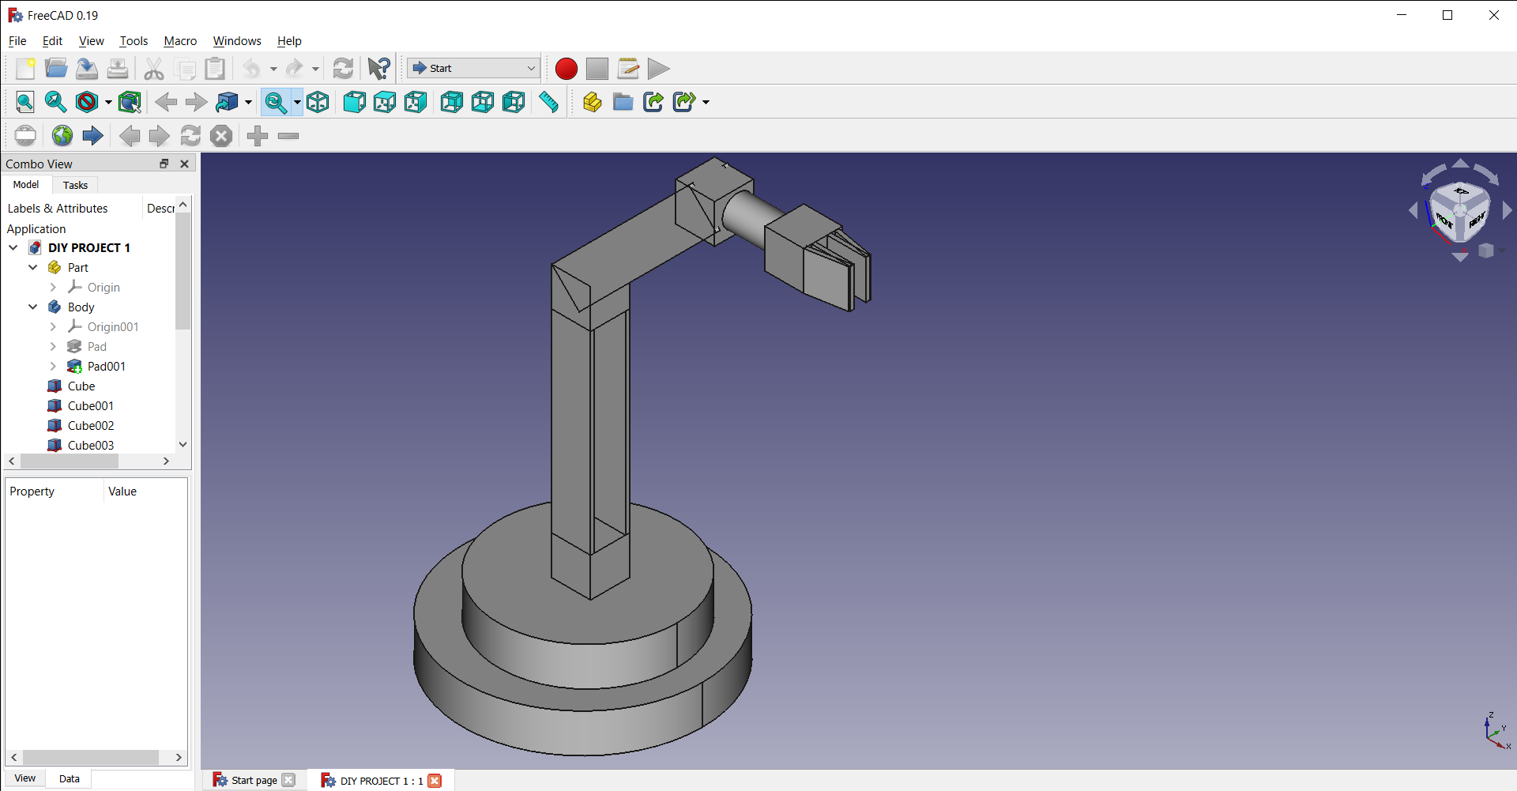
FREECAD MODEL

Slide 4
Freecad MODEL
A virtual model was made in Freecad by Srinivas and Sarthak.
A physical model was not made due to the high cost for printing the body using a 3d printer (cost of 3d printer alone was about 30k rupees)

Slide 5
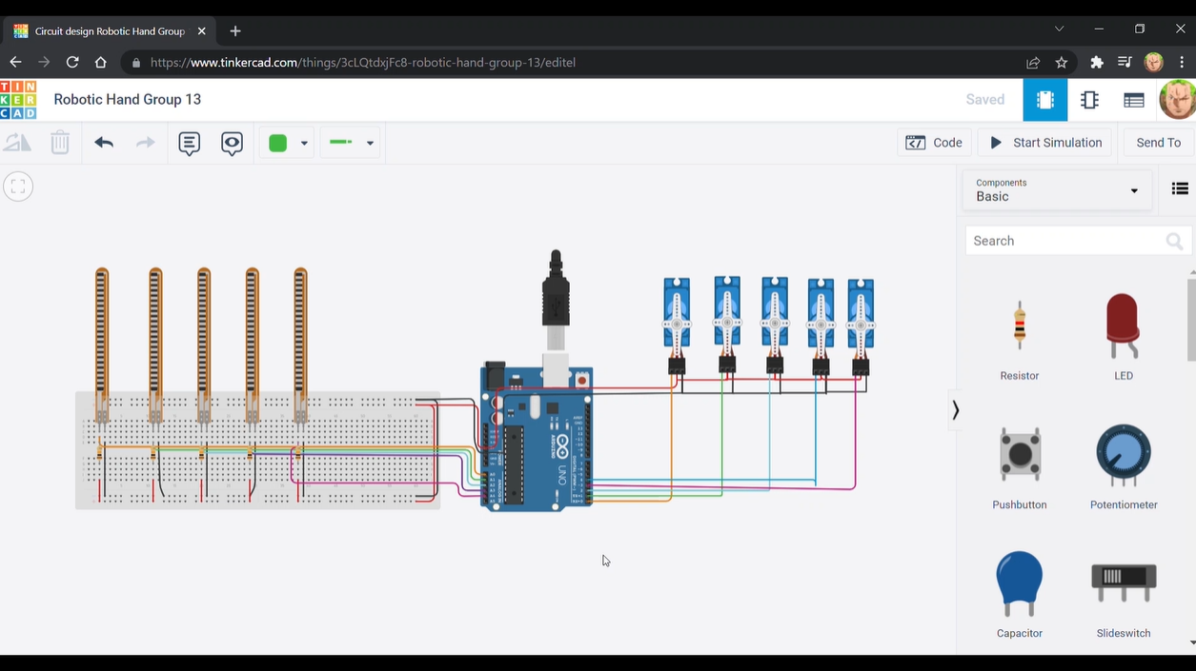
CIRCUIT

Slide 6
CIRCUIT AND CODE
The circuit and code were made as a Tinkercad model by Sandeep and Abhishek.
Circuit link:
https://www.tinkercad.com/things/6NCMxxoRteC-copy-of-robotic-hand-group-13/editel?sharecode=uyt1RlPhYDrolcmDd6_O3oMlWqSt1Z-YERKlFO9QUY8

Slide 7
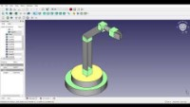
VIDEO LINK

Slide 8
CONTRIBUTIONS BY EACH MEMBER
A.K.L. Sriniwasa – Helped in making the Freecad model, in research for the arm and in making the final presentation and parts of video link.
Sarthak F- Idea of the project , coordinating group members and final lab report writing.
Abhishek- Making the previous presentations, circuit for arm in Tinkercad and final editing of the video.
Sandeep P- Research for the robotic arm , helping Abhishek with coding in Tinkercad and in parts of video.

Slide 9
THANK YOU

